Slide 1
Geology tools

Slide 2
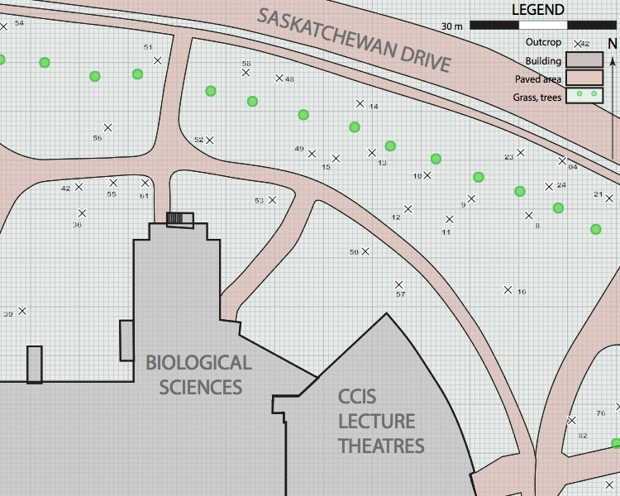
07
Bedding
Rock Units (observed, inferred)
07
07
Enter unit name here
upright, overturned, unknown
Enter unit name here
Glacial striation
42
Slickenline lineation
Enter unit name here
Cleavage plane
Fault plane
Enter unit name here
77
77
Enter unit name here

Slide 3
Graph paper

Slide 4
Written work

Slide 5
Wulff net
Net created with Spheristat™ from Pangaea Scientific

Slide 6
Schmidt net
Net created with Spheristat™ from Pangaea Scientific

